Slide 1
Internet Connection Sharing
Kostas Tzoumpas, Marco Zenere
Cloud Computing and Distributed Systems - Project Presentation

Slide 2
Table of contents
Motivation Scenario and Domain Specification
System Architecture - Server side
System Architecture - Client side
Difficulties
Further improvements

Slide 3
Motivation Scenario
People would prefer to use an internet connection that is safer and faster than free hotspots normally available in cafes, hotels, or public places
Anyone can share his/her home internet connection and gets paid for it
Anyone can have access to his/her own private network from anywhere

Slide 4
Domain Specification
Internet sharing system involving an Ethereum Blockchain with smart contracts
Ethereum cryptocurrency as only payment method acceptable
Connection is made in OpenVPN and cancelled when contract expires

Slide 5
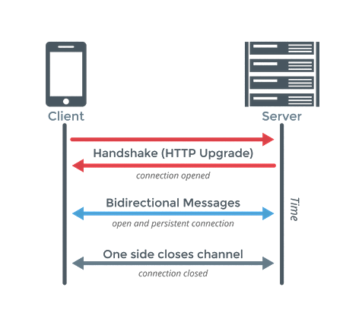

System Architecture - Server side
Set up with:
OpenVPN server running
Websockets script (in Python)
Bash scripts for managing VPN profiles
Other configuration:
Port forwarding
Linux firewall allowing connections
Dynamic IP is accessed through a hostname (noip.com)

Slide 6

System Architecture - Client Side
Ganache for managing the Blockchain system
Lite-server as development platform for the Web Server
Further information
Web Server developed starting from the Pet-Shop example provided by Truffle
HTML, CSS, Javascript for implementing the Web page appearance and all the logic behind
Communication with the server via web browser Javascript WebSocket package

Slide 7
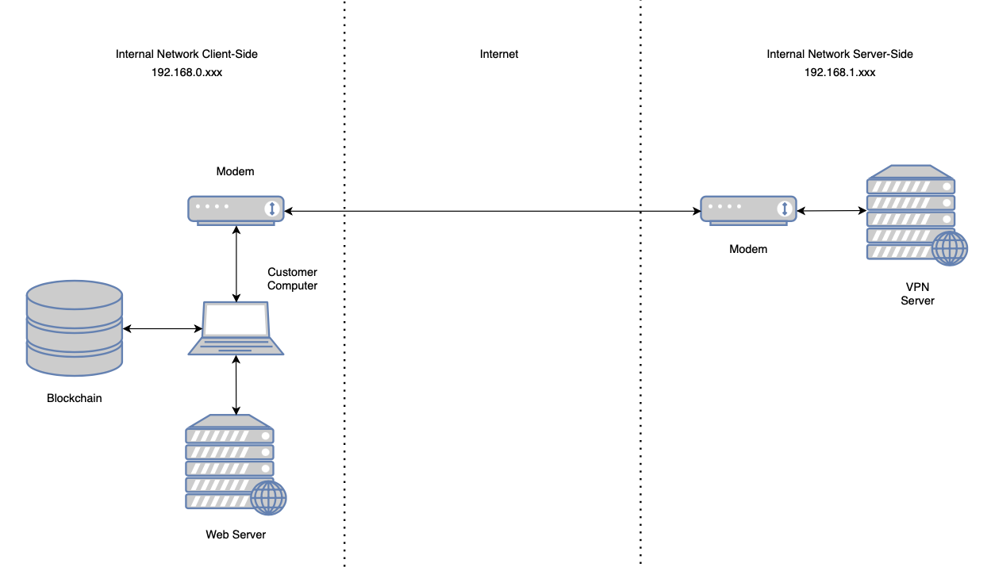
System Architecture - Overview

Slide 8
Difficulties
Communication between Client and Server:
  Using a Web browser as Javascript interpreter, getting the functions and methods via require keyword doesn’t work
  Generally, difficult to achieve communication through different systems due to lack of experience in such projects
WebSocket communication
  Without encryption due to errors with certificates in browser (client side)
Metamask bugs with Ganache & local network
OpenVPN server configuration
  Solved by a script found in Github (openvpn-install)

Slide 9
Further Improvements
Migration of the web server to Amazon AWS EC2 instance
  Web page accessible from anyone and everywhere
Migration of the blockchain in a public test network
  Rinkeby test network
  Or even the main Ethereum blockchain
Improvement of the client-server communication
  Using a secure Websocket address with the use of trusted certificates (wss instead of ws)

Slide 10
Thank you
(Demo time)

